Slide 1

Machine Learning Techniques Project
Determination of Key Parameters afftecting House Pricing
using Multiple Linear Regression
Submitted To:
Prof (Dr.) Siby Abraham
GROUP: 6
HARSH JAYKUMAR
RADHIKA PANGASA
RIDDHI BHATIA
SALONI BANSAL
SHRIYA SRIVASTAVA
VAIBHAV SHARMA

Slide 2
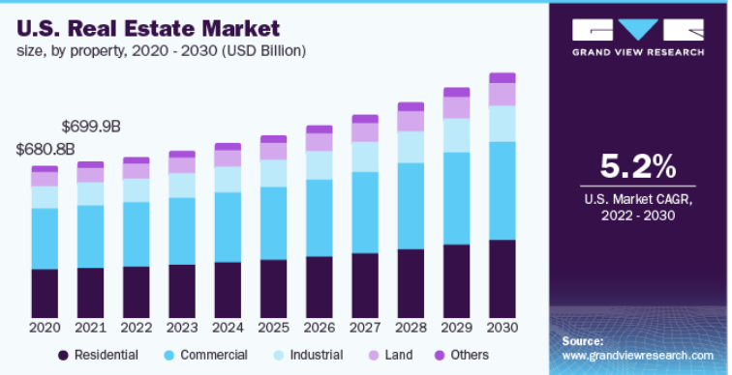
Online Property Valuation- Present and Future Scenario
Machine-Learning (ML) holds great promise for real estate valuation. But relevant, high quality and timely real estate data remain an expensive input.
Business Aspects
In between transactions, real estate professionals and investors need to rely on valuations — the most likely price to be obtained in the market had the property been put up for sale.
Regression algorithms predict the continuous value i.e. the expected price of a house and we have used Multiple Linear Regression to train and test the data and come up with an accurate model.

Slide 3
MLT
Machine Learning as a Process
Define Objective
Data Preparation
Model Building
Model Evaluation
Model Deployment
•Define measurable and quantifiable goals
•Use this stage to learn about the problem
•Normalization
•Transformation
•Missing Values
•Outliers
•Data Splitting
•Features Engineering
•Estimating Performance
•Evaluation and Model Selection
•Study models accuracy
•Work better than the naïve approach or previous system
•Do the results make sense in the context of the problem
The integration of the model into an existing production environment which can take in an input and return an output that can be used in making practical business decisions.

Slide 4
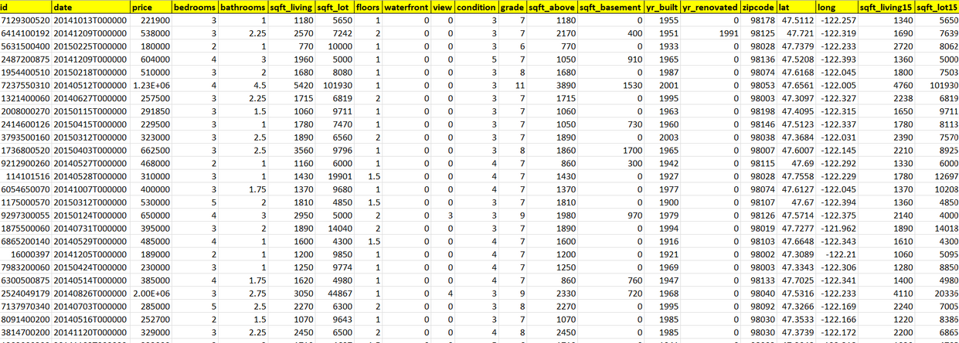
Dataset and Our Objective
The dataset consists of house prices from King County an area in the US State of Washington, this data also covers Seattle.
The dataset consisted of 21 variables and 21613 observations.
Each row describes the various features of a particular house.
The aim of this Project is to predict the pricing of houses given in the dataset, using Multiple Linear Regression (MLR). The dataset consisted of historical data on homes sold between May 2014 to May 2015.
Our target variable is prices.

Slide 5
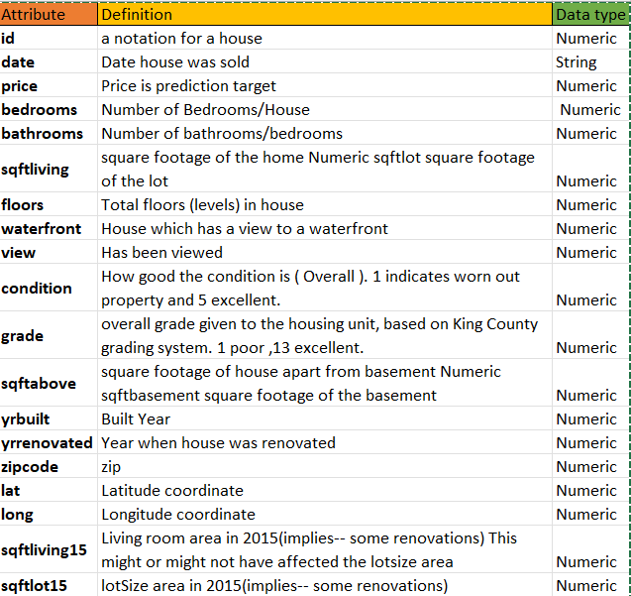
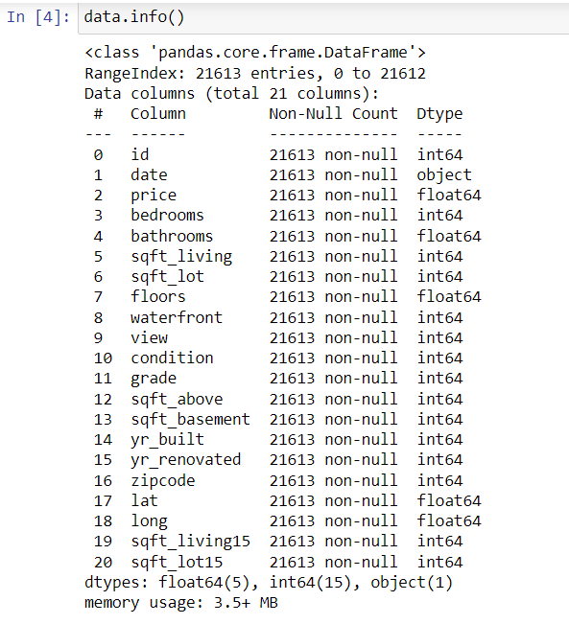
Data Definition

Slide 6
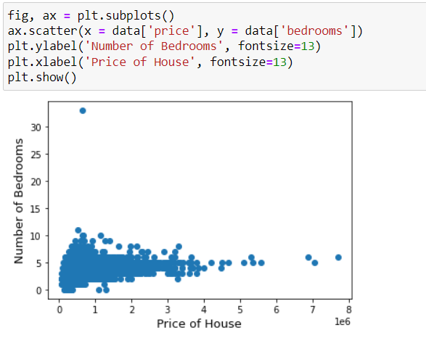
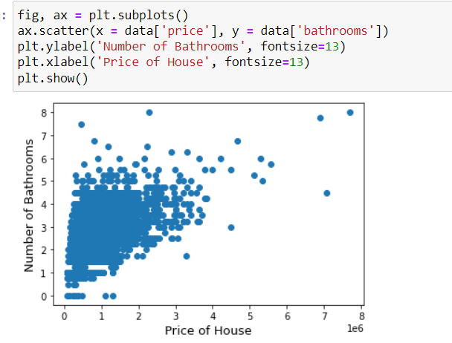
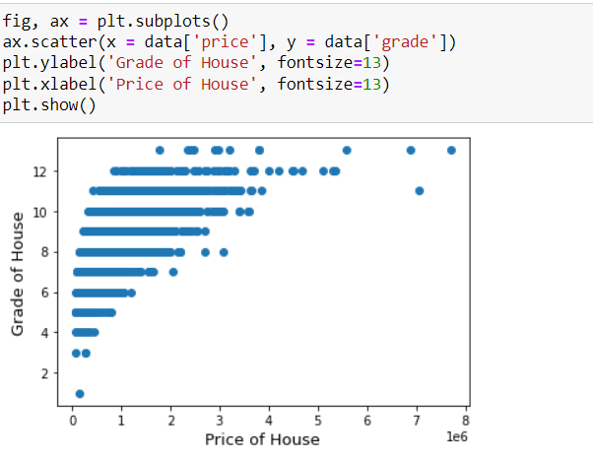
Exploratory Data Analysis

Slide 7
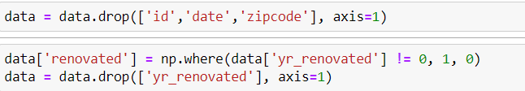
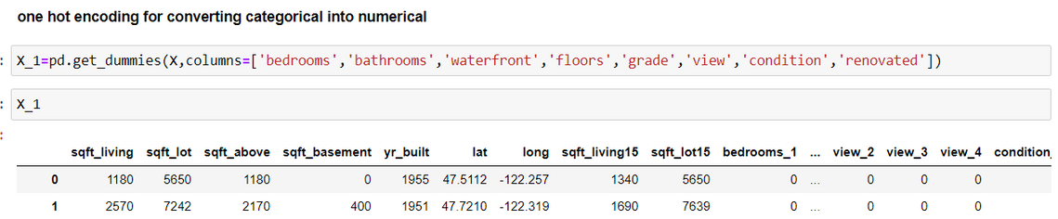
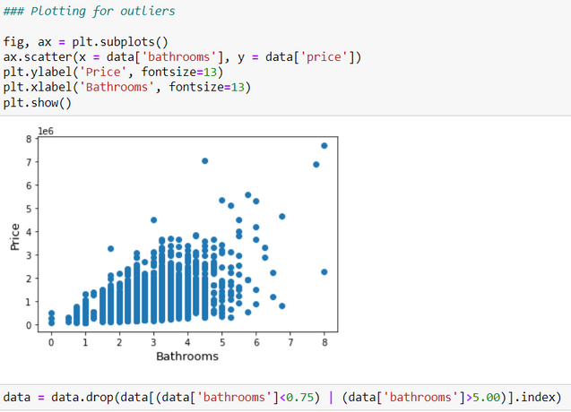
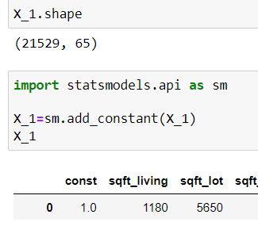
Data Preprocessing
Dropping non-useful data and outliers
and adding constant
Implementing Feature Encoding Technique
using One Hot Encoding

Slide 8
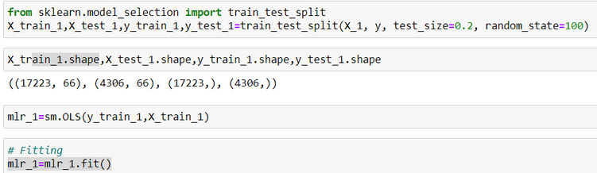
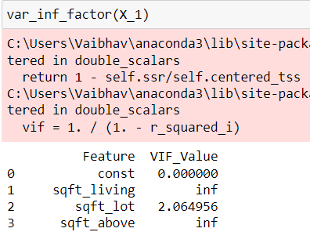
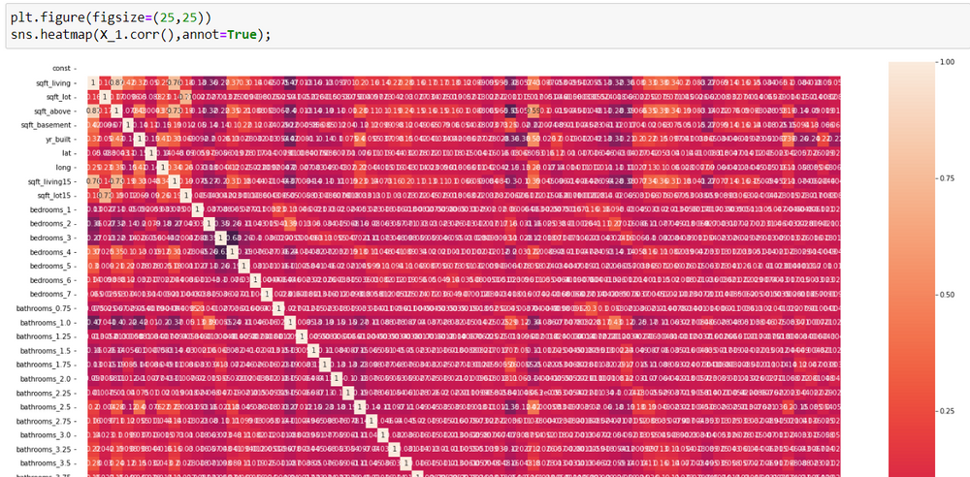
Multiple Linear Regression Model Building
Model Creation
•Data is Split into Test and Train data
•Training of the data is done using OLS Model
Model Evaluation
•Determining the R-squared value
•Check value P-value
•Check for multicollinearity

Slide 9
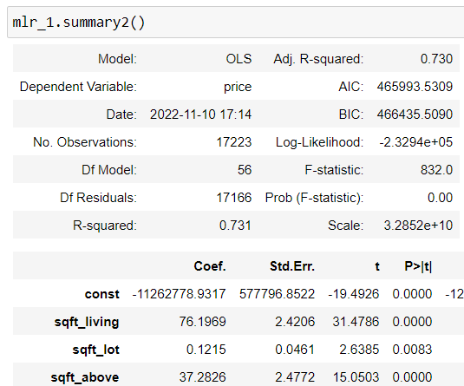
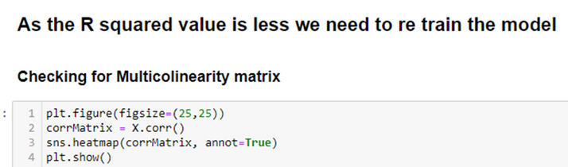


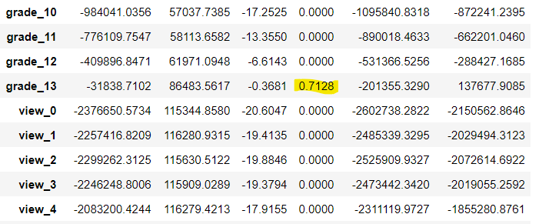
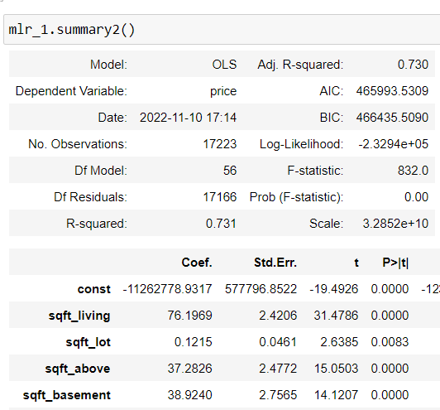
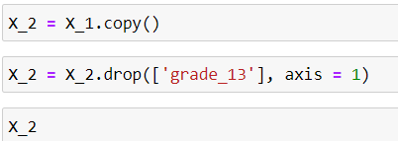
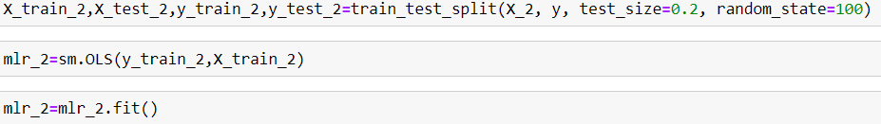
Iterations and Retraining of Model
The feature 'grade_13' has p-val more than alpha value i.e. 0.05 hence we will drop that feature
MODEL 1
MODEL 2
Retraining the model to check for any changes in R-squared value or collinearity.

Slide 10
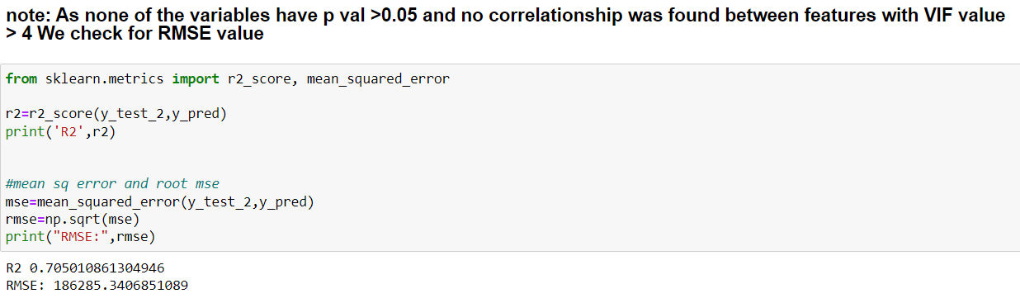
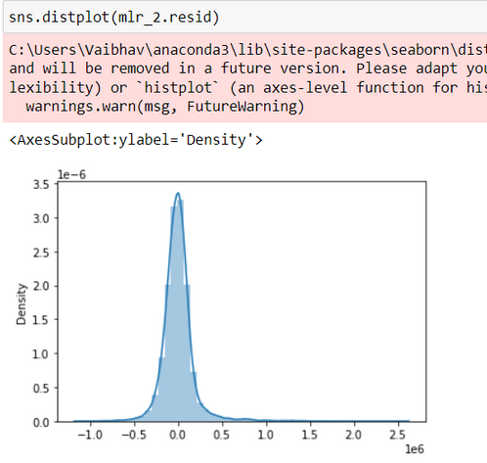
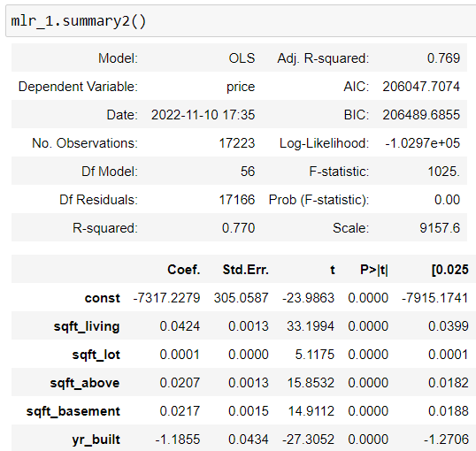
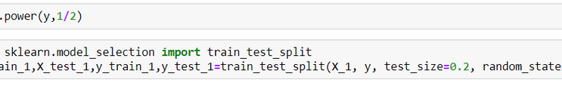
Iterations and Retraining of Model
We can see that the RMSE value is not in the range of 0-1 and is evidently high:
RMSE: 186285.3406851089
As our RMSE value is too high,
we will now take the square root of y
as our target variable
MODEL 3

Slide 11
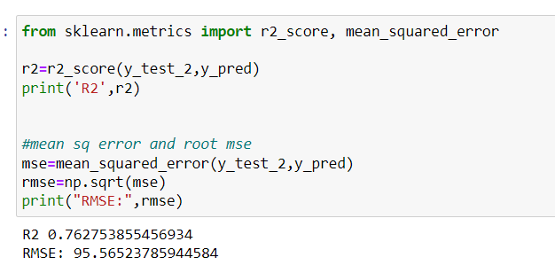
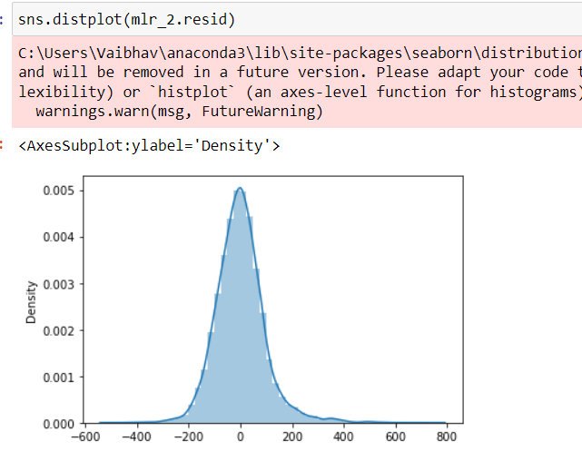
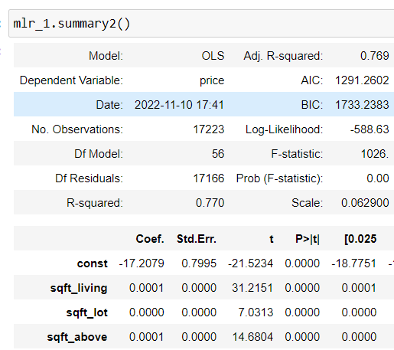
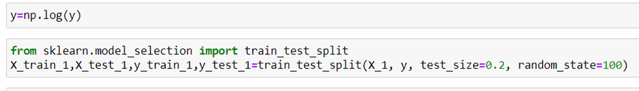
Iterations and Retraining of Model
We can see that the RMSE value is not in the range of 0-1 but has reduced to a value of: RMSE: 95.56523785944584
As our RMSE value is still quite high,
we will now take the log of y
as our target variable
MODEL 4

Slide 12
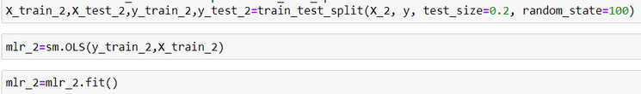
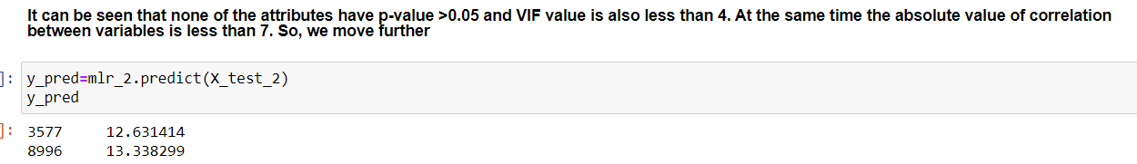
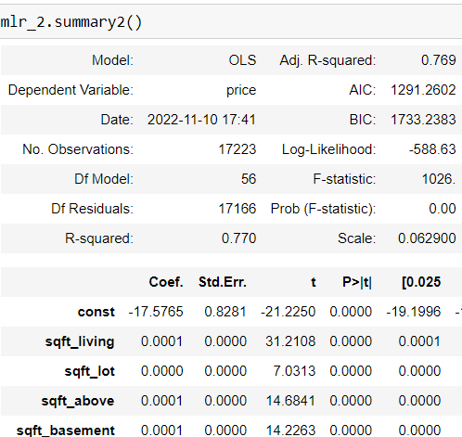
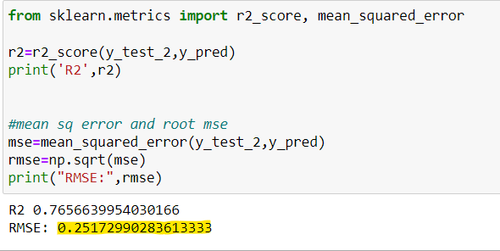
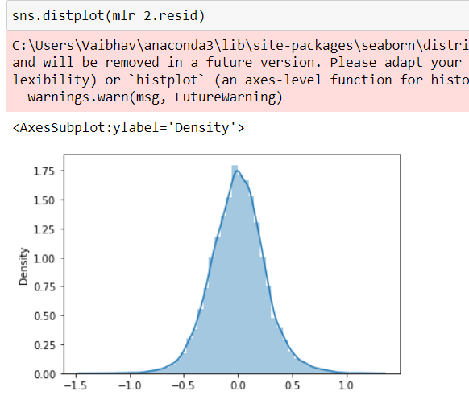
Final Model
We check for RMSE value:
After multiple iterations and retraining of the model we obtained the final R-squared value of 0.77 ; which explains that 77% of our data fits the Multiple linear regression model

Slide 13
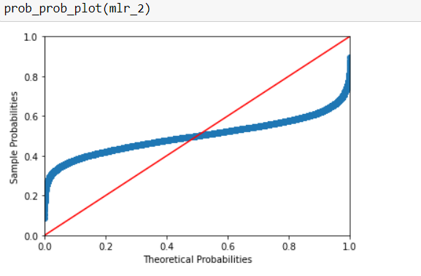
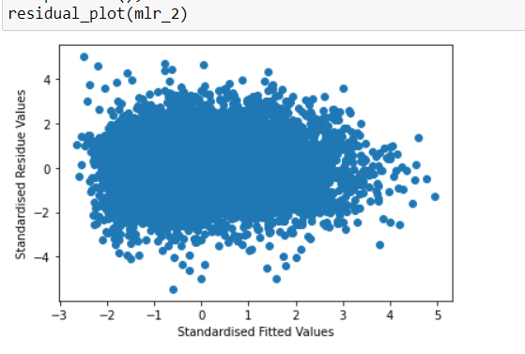
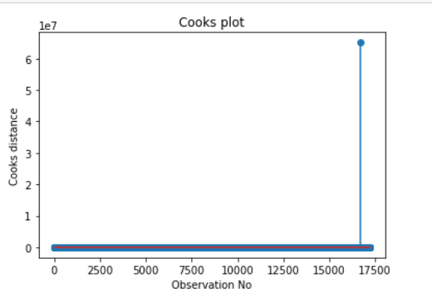
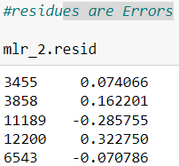
Model
Diagnostics
Test of Normality
Probability Probability Plot
Residual Plot
Cook's Plot
Influence Plot
R2 Score and RMSE value
Test of Normality

Slide 14
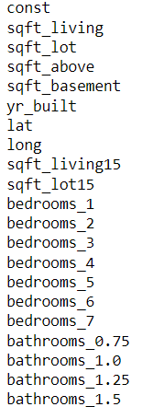
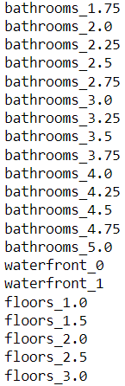
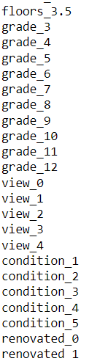

MODEL PERFORMANCE
Hence, these are the Key Parameters to predict the price of houses
according to the dataset of King County, in the US State of Washington
R-squared value – 0.770
R2 value – 0.765
RMSE Value - 0.251
By the model that we have built, we can conclude that after dropping the outliers, checking for and removing multicollinearity, transforming the variables, and rebuilding the models accordingly, our R score is ~77%,so the features chosen and the model built is fitting the dataset well but we could try other models in future for the same dataset in order to have better Housing Price Predictions.

Slide 15
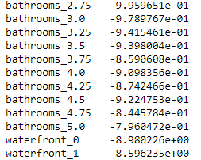
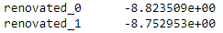
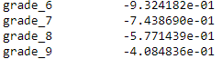
MANAGERIAL INSIGHTS
Out of all the dummy columns created with the help of one-hot encoding,
the values that you see to right side of the slide have a bigger impact on the Price of the house as they
have a high param value
R-squared value – 0.770
R2 value – 0.765
RMSE Value - 0.251
Number of Bathrooms greater than 2.75
Having a house near or not near a water front has an equal effect on the Price of the house

Slide 16
Thank you!
Group 6

